Slide 1
Intra-Datacenter Load Balancing in a Federated Cloud with Throttled Algorithm
Presented By-
Himani (M23CSA516)
Ankit Kumar Chauhan (M23CSA509)
Instructor- Dr. Sumit Kalra

Slide 2
Problem Statement
Problem Addressed: The project addresses uneven load distribution within datacenters in a federated cloud environment, which leads to reduced Quality of Service (QoS) and Service Level Agreement (SLA) violations.
Context: Federated clouds aggregate resources from multiple cloud providers but struggle with intra-datacenter load imbalance, causing inefficient resource utilization and delayed response times.
Importance: This issue is critical in cloud computing as effective load balancing ensures optimal performance, scalability, and cost-efficiency while meeting user demands.

Slide 3
Literature Review
Hybrid Load Balancing Algorithms:
MMRR Algorithm: Combines maximum-minimum and round-robin methods to improve response times but fails to consider dynamic VM states during high-load periods.
HAMM Algorithm: Hybrid of min-min and max-min algorithms, achieving 89.6% makespan and 89.5% resource utilization but lacks AI integration.
Nature-Inspired Approaches:
Genetic algorithms and honeybee-inspired strategies are more adaptive but often require complex parameter tuning and computational overhead.
Throttled Load Balancing Algorithm:
The throttled algorithm serves as the basis for this work, showing promise in dynamically allocating tasks based on real-time resource availability but requiring adaptation for federated environments.
Comparative Reviews of Cloud Simulators:
Evaluations of tools like CloudAnalyst and CloudSim highlight the importance of simulation-based validation.

Slide 4
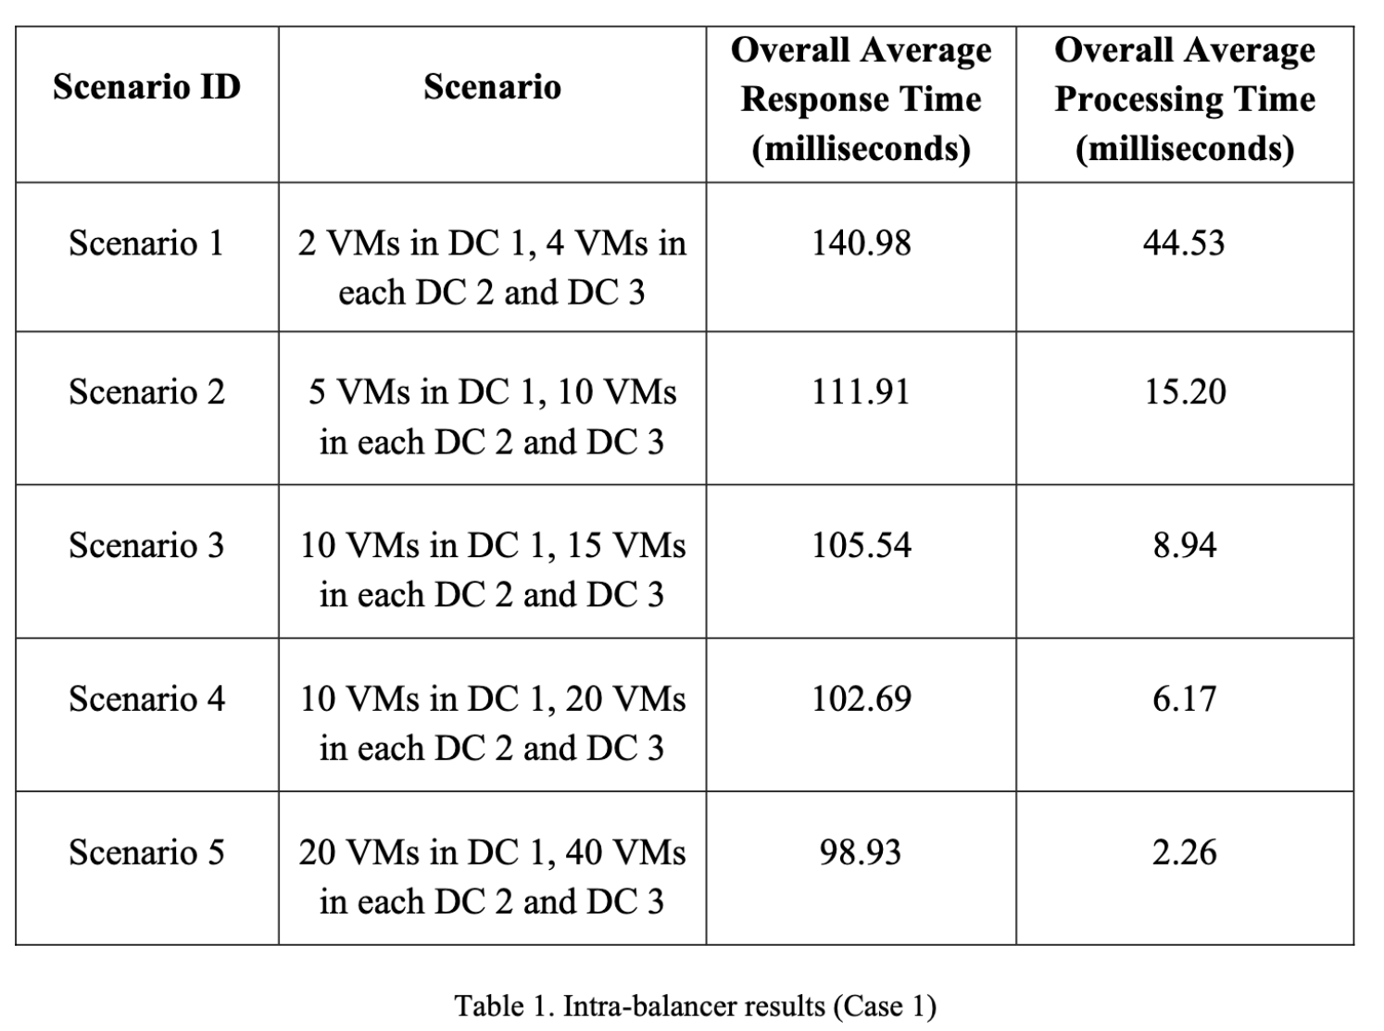
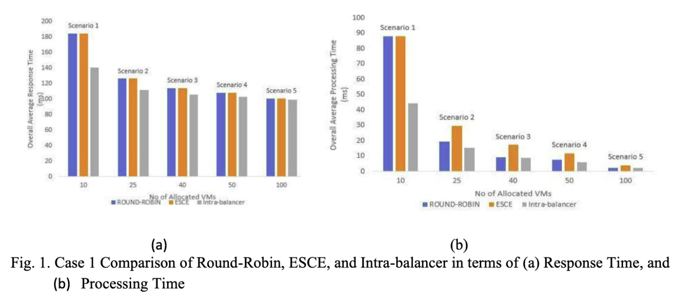
Existing Results
Test Case 1:
Scenario 1 to Scenario 5: Varying the number of VMs from 10 to 100 resulted in a decrease in both response time and processing time.
Results:
With 100 VMs, the intra-balancer achieved an average response time of 98.93 ms and processing time of 2.26 ms.

Slide 5
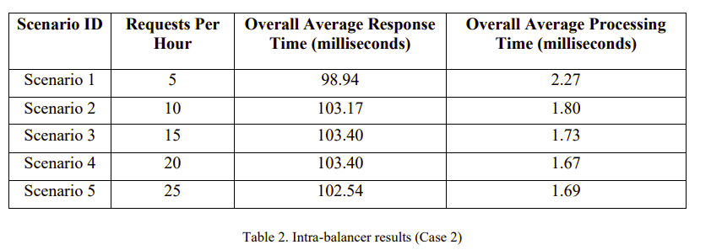
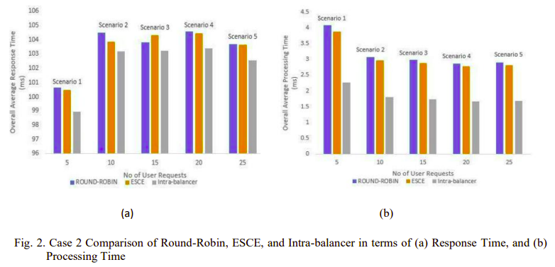
· Test Case 2:
Scenario 1 to Scaneario 5: By varying the number of requests per user base while keeping the total number of VMs constant (100 VMs).
Results
The intra-balancer consistently maintained response times around 98–103 ms and processing times near 1.7–2.3 ms.

Slide 6
Our Implementation
Content:
Step 1: Environment Setup:
Installation of Java SDKs and Java IDE.
Downloading and importing the CloudAnalyst project into the IDE.
Step 2: Algorithm Adaptation:
The throttled algorithm was adapted for intra-datacenter balancing. It continuously monitors VM states (Available vs. Busy).
A table of VMs is maintained, allowing the load balancer to assign requests to the first available VM. If none is available, the request is queued.
Step 3: Simulation Execution:
Simulated on CloudAnalyst by altering the number of VMs and user request rates. Performance metrics like response time and processing time were recorded.
Step 4: Validation:
Results were compared with Round-Robin and ESCE algorithms to evaluate improvements.

Slide 7
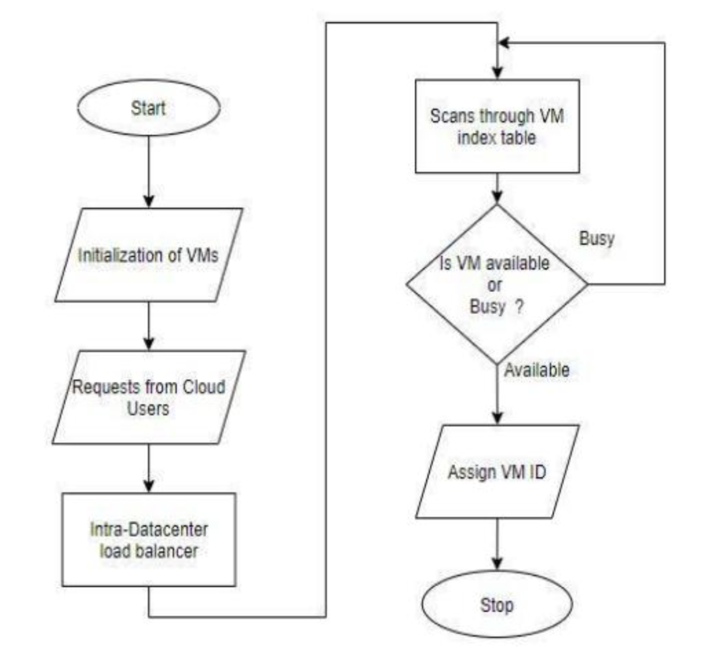
Fig: The Flowchart of the Proposed Intra-Datacenter Load Balancing Algorithm

Slide 8
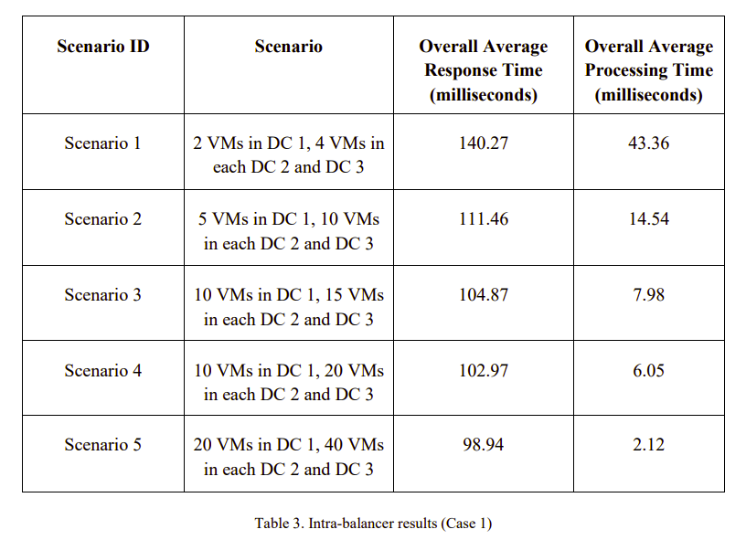
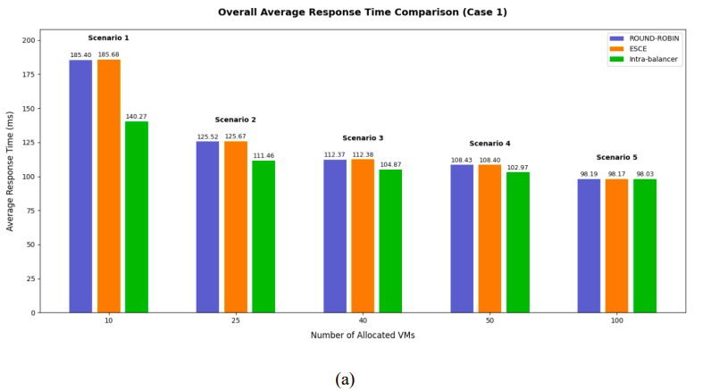
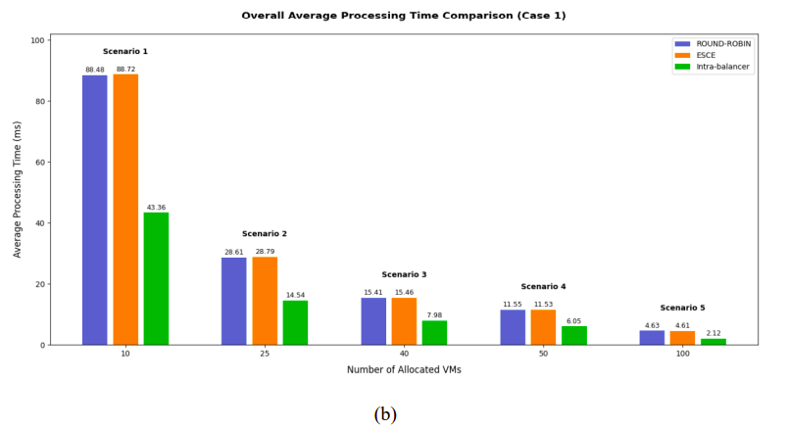
Our Results
Test Case 1:
Improved Latency: Achieved an average response time as low as 98.03 ms in high resource scenarios.
Enhanced Processing Efficiency: Processing times as low as 2.12 ms.
Scalability: Response and processing times improved as the number of VMs increased.

Slide 9
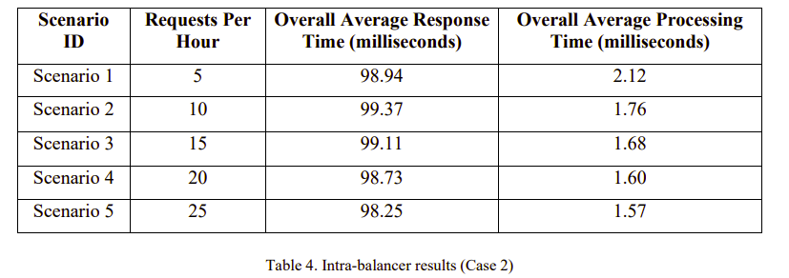
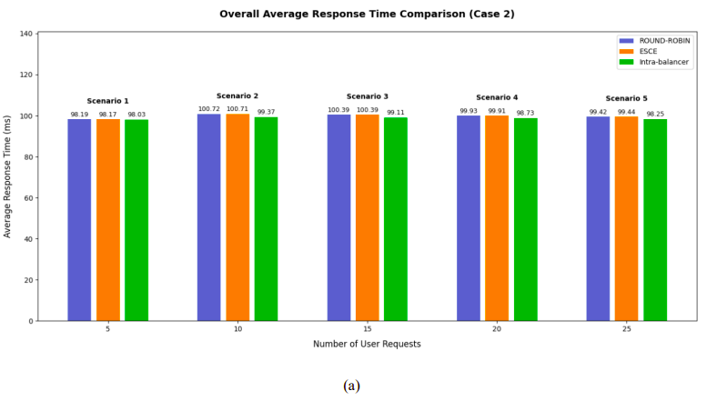
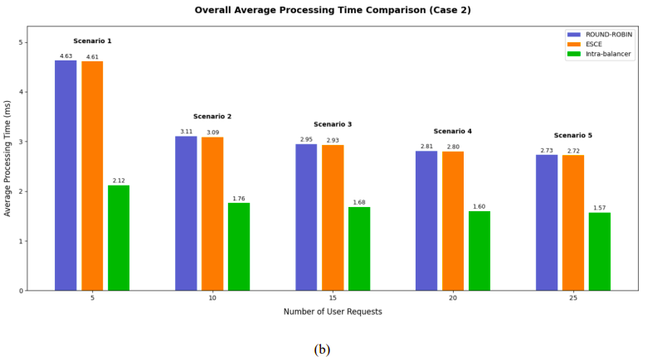
Test Case 2: By varying the number of requests per user base while keeping the total number of VMs constant (100 VMs), the intra-balancer consistently maintained response times around 98–99 ms and processing times near 1.6–2.0 ms. Table 4 and Fig. 4 denotes this.

Slide 10
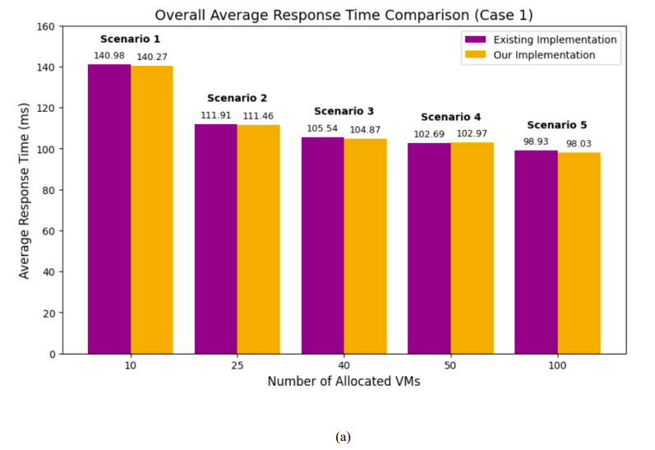
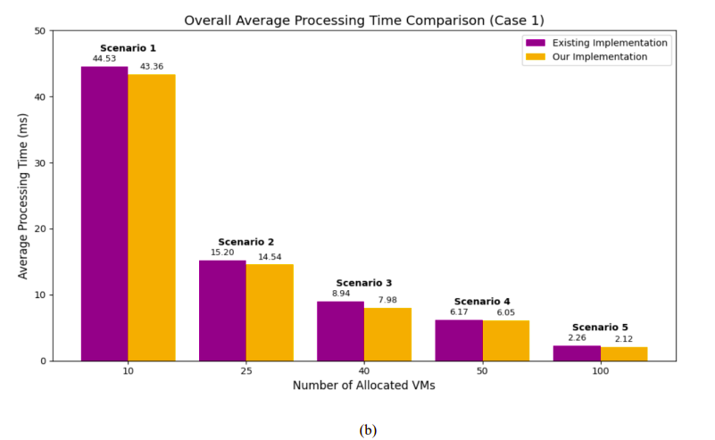
Comparison and Analysis
Key Findings (Test Case 1):
Response Time: The intra-balancer consistently achieved lower response times (98.03 ms with 100 VMs) compared to Round-Robin and ESCE.
Processing Time: The intra-balancer reduced processing time to 2.12 ms, outperforming traditional methods.
Efficiency in Resource Utilization: The algorithm minimizes idle time and optimizes the use of cloud resources.
Fig. 5. Case 1 Comparison of existing and our implementation of Intra-balancer in terms of (a) Response Time, and (b) Processing Time

Slide 11
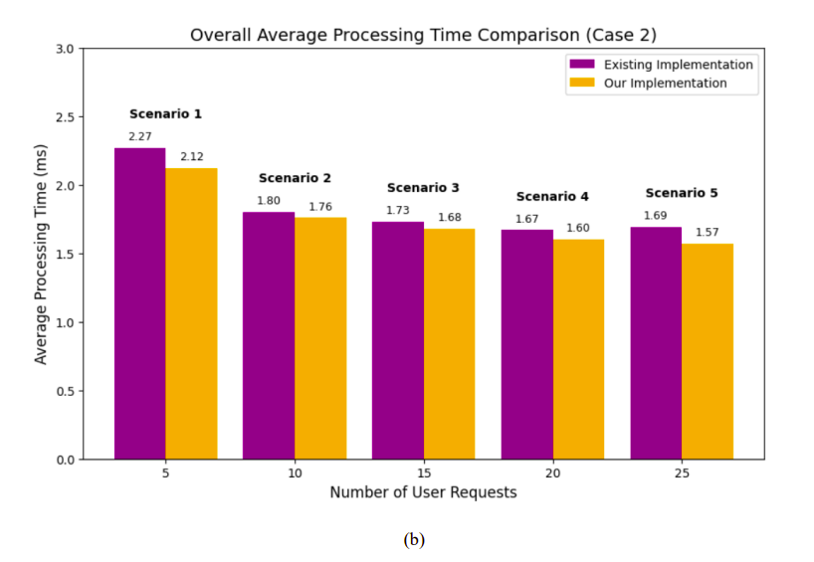
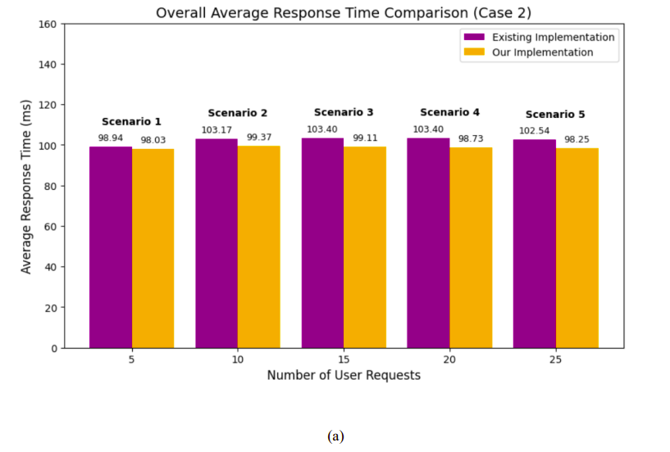
Key Findings (Test Case 2):
Fig. 6. Case 2 Comparison of existing and our implementation of Intra-balancer in terms of (a) Response Time and (b) Processing Time

Slide 12
Future Scope
AI/ML Integration: Implement machine learning algorithms to dynamically predict VM workload and optimize request distribution.
Enhanced Security: Implement security protocols and fault tolerance mechanisms.
Advanced Simulation Models: Use real-time monitoring systems to refine the load balancing strategy.
Conclusion
The proposed intra-datacenter load balancing algorithm successfully adapts the throttled algorithm to federated clouds, improving response and processing times.
Future work includes AI/ML enhancements and advanced optimization techniques.

Slide 13
Thank You

